Slide 1
ChatGPT , GPT Plus, bard

Slide 2
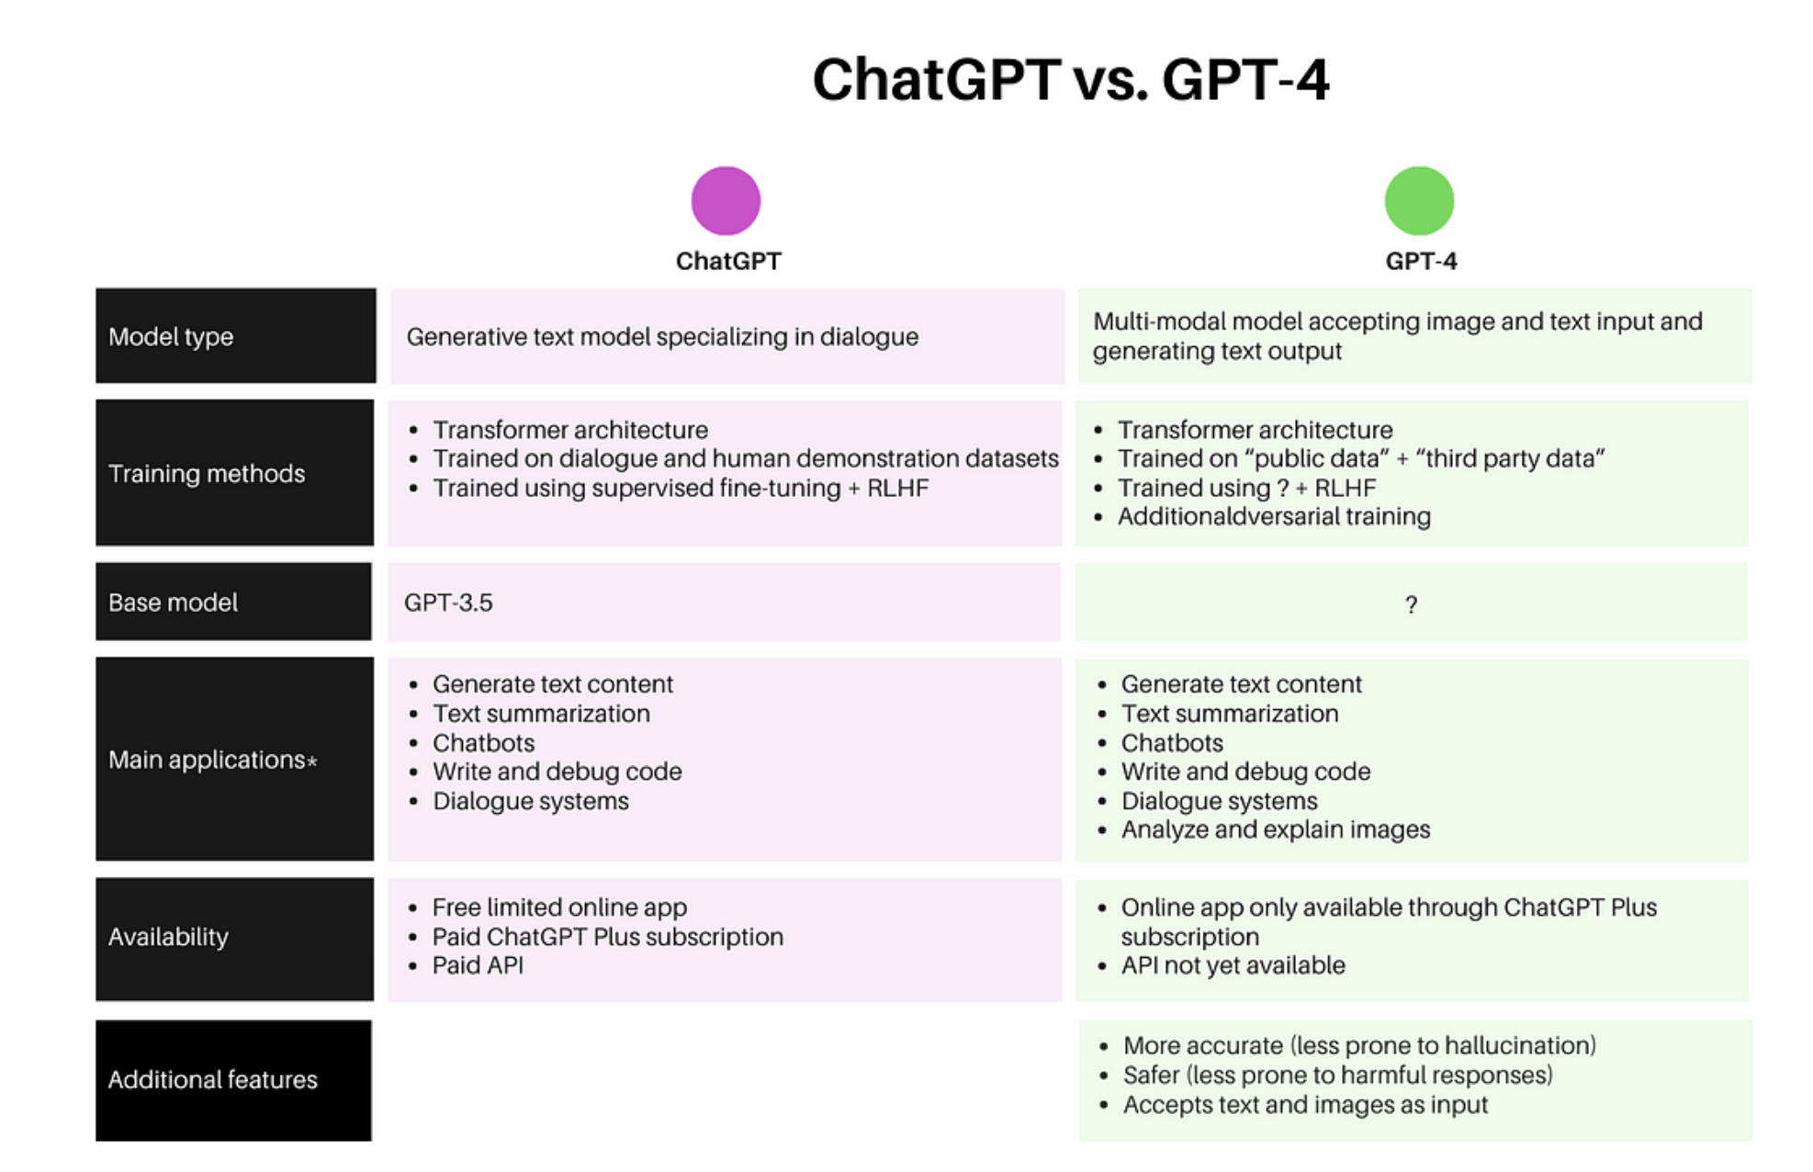
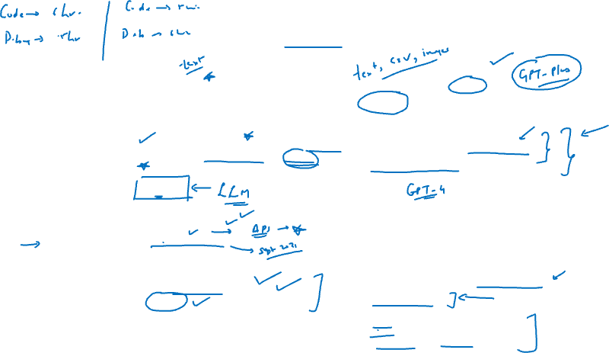

Slide 3

ChatGPT Additional feature
With help of “file uploader extension” in ChatGPT we can actually upload a file and ask ChatGPT questions from the same file. It also provides the summary of the file
Use below link to get “ChatGPT file uploader extension”
https://chrome.google.com/webstore/detail/chatgpt-file-uploader-ext/becfinhbfclcgokjlobojlnldbfillpf/related

Slide 4
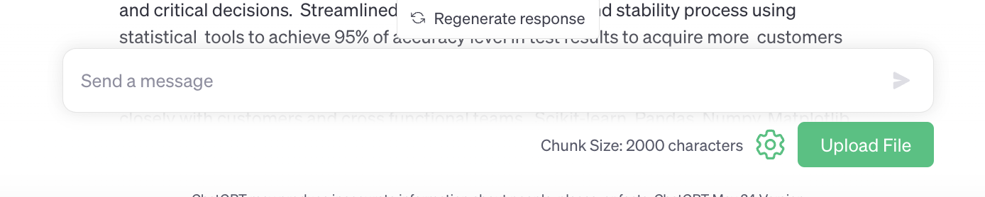

Refresh ChatGPT page and the prompt bar now looks as shown below

Slide 5
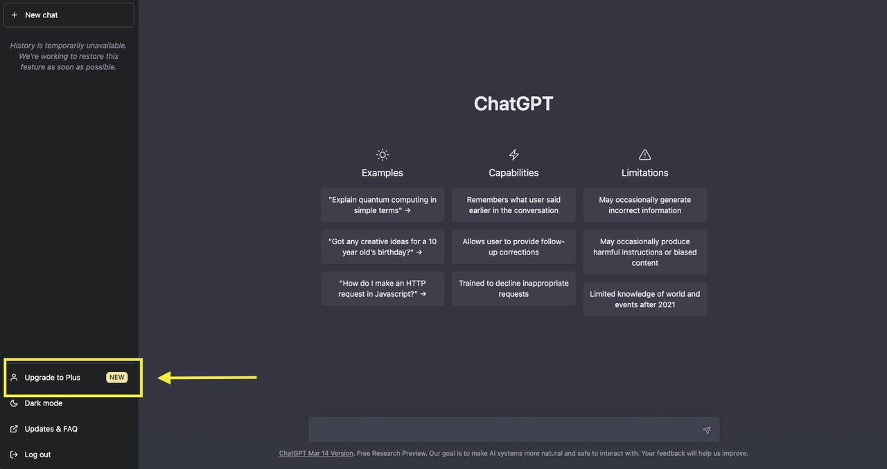

ChatGPT Plus
ChatGPT plus is based on GPT 4.0

Slide 6
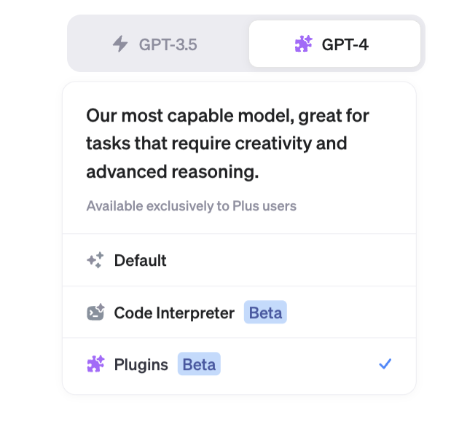

It costs $20 per month (approx. $24 including taxes)
It offers two extremely good features
Select Plugins

Slide 7
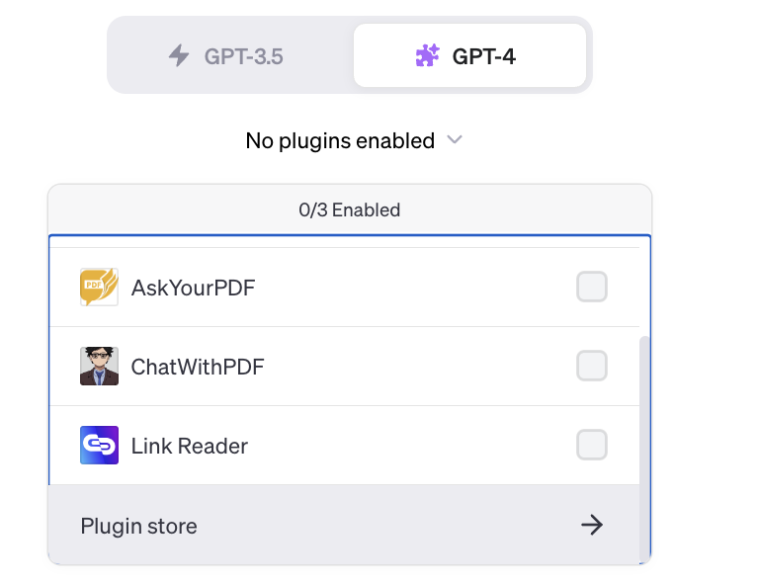

Then click on plugin store
It offers different plugins
You can click and install them

Slide 8
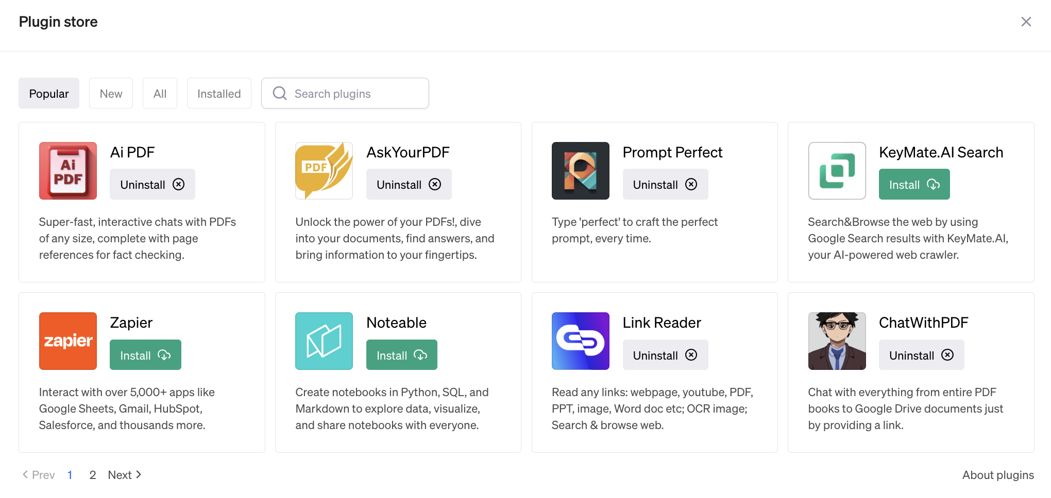


Slide 9
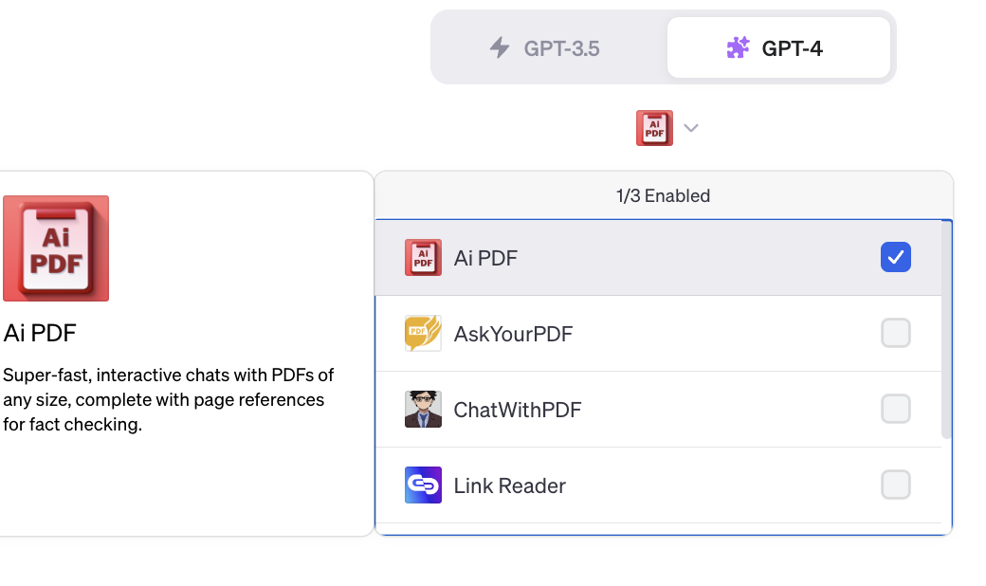

The installed plugins will be shown in the drop down. You may select the check box to enable them while working on ChatGPT plus

Slide 10

Code Interpreter
The new feature “code interpreter” was launched on 9th July 2023
It is a powerful feature that helps you analyze, visualize and compare datasets with a single click.
It opens the data as a pandas dataframe at the backend.

Slide 11
